Slide 1
Car Price Prediction Project
by
Vaishnavi Balaji
Internship-31
SME- Gulshana Chaudhary
Flip Robo Technologies
#39, NGEF Lane, 2nd Floor, Suite No.1759, Indiranagar, Bangalore, Karnataka, India 560 038

Slide 2
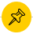
Table of Contents
Problem Statement
Aim and Objectives
Introduction
Exploratory Data Analysis
Data Pre-processing
Model Training and Testing
Conclusion

Slide 3
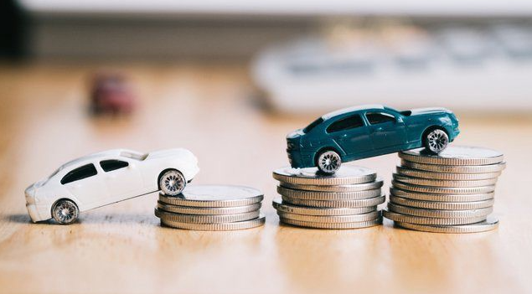
Problem Statement
The COVID 19 market impact has led to a number of changes in the automotive sector.
Now, certain cars cost more because there is a huge demand for them, while others cost less because there isn’t.
One of the customers deals with small businesses that sell used cars. The market changes brought on by the impact of COVID19 are causing problems with their prior machine learning models for assessing automobile costs.
They are looking for new machine learning models using new data as a result.

Slide 4
Aim :
The goal is divided into two sections, first is data scraping of used cars from car portals like “cardekho”, “cars24”, “olx”. Secondly develop a regression model to predict the price of used cars.
Objectives :
Data Collection using Web Scraping from car portal.
Perform Exploratory Data Analysis on the data set.
Handle numerical and categorical variables.
Analyse the relationship between the features and target.
Train multiple models and select the efficient model.
Perform hyperparameter tuning on the selected model and analyse the performance metrics.

Slide 5
Introduction
In 2020, the Indian used automobile industry brought in $18.3 billion, and between 2021 and 2030, it is anticipated to increase at a CAGR of 14.8%.
The growing consumer focus on high-quality, reasonably priced vehicles and rising preference for imported cars are the key factors driving the market for used cars in the nation. Additionally, the increased quality of old cars following thorough servicing by the dealers is changing consumers' perceptions of how long they will survive.
The used automobile industry in India has been impacted by the COVID-19 outbreak, notably the numerous lockdowns that were implemented in its wake.
Due to the pandemic's severe effects on market participants' businesses, workers no longer receive remuneration, and there has been a decline in global trade.
In particular, consumer demand, communication, operations, and the supply chain have all been affected negatively by the outbreak. The economic downturn brought on by the coronavirus has also significantly decreased consumer purchasing power, which has a negative impact on used automobile sales.

Slide 6
Exploratory Data Analysis
For the data collection, data of 7980 cars are scraped from “car dekho” portal using Selenium Web Driver. The three parameters based on which the used cars data is collected are- Fuel, Kilometers-driven, Transmission and Price. After analysing the data the following conclusions are made-
The database dimensions are 7980 rows and 4 columns. Fuel, Transmission and Kilometers-driven are of object type hence Kilometers-driven column has to be converted to numeric type.
There are no null values in the dataset.
Kilometers_Driven denotes the number of kilometers the used car has driven before the sale.
Fuel provides the type of fuel in the car, values for this feature are-“Petrol”,”Diesel”,”CNG”.
Transmission denotes the type of transmission of the car-Automatic or Manual.
Price column gives the selling price of the used cars in lakhs.

Slide 7
Contd.
When graphical analysis was performed on the features of the data, the following points were observed:
The feature-Kilometer-driven is ranging from 5000 to 125000 and 1300-1400 cars have 30000 to 50000 kilometres-driven.
4500 cars have Petrol fuel and 3500 cars have Diesel fuel and very few cars have CNG type fuel.
6200 cars have Manual Transmission and 1600 cars have Automatic Transmission.
5500 cars have price from 2-5 lakhs followed by 1600 cars have price from 5-15 lakhs.

Slide 8
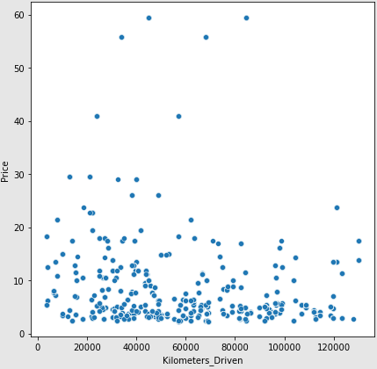
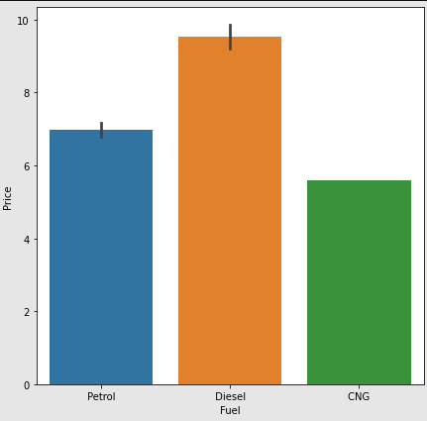
Contd.
When the car has less kilometres driven the price is higher.
With respect to fuel, used cars with Diesel fuel have higher price followed by Petrol and CNG.

Slide 9
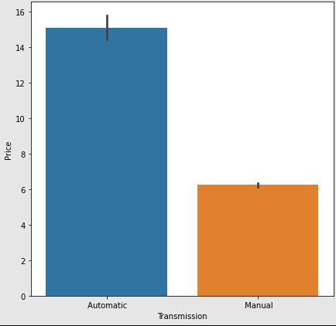
Contd.
Automatic Transmission cars have higher price compared to Manual Transmission cars. Automatic cars have price of 15 lakhs and Manual cars have price of 6 lakhs.

Slide 10
Data Pre-processing
The column “Unnamed: 0” is removed since it replicates the index. “Kilometers_Driven” column consists of the distance covered by the car which is of numeric type but the type is of object which is converted to integer type.
“Fuel” and “Transmission” are of object type which are hence encoded using Label Encoder.
There are few data points beyond the range as observed in the box plot. After determining the z-score for the dataset the data points of z-score beyond the value 3 are eliminated. The elimination of outliers gave rise to a data loss of 2.14%.
The features – Kilometers_Driven, Fuel and Transmission and target – Price are split from the dataset.
The features are scaled using Min Max Scaler algorithm, this estimator scales and translates each feature separately so that it falls within the training set's defined range.
To give features a more Gaussian appearance, a class of parametric, monotonic adjustments called power transforms is used.

Slide 11
Model Training and Testing
The features and target are split using the train_test_split function in sklearn, and a loop is defined to obtain the random state value for the function which yields best results. The algorithms which were used in training and testing the model are:
Linear Regression
Random Forest Regression
Decision Tree Regression
K Neighbours Regression
Support Vector Regressor
Gradient Boosting Regressor
XGB Regressor
Ada Boost Regressor
The Random Forest Model and Decision Tree Model are efficient models since Linear Regression and K Neighbours Models are having low r2 score for both training and test data.

Slide 12
Conclusions
The Random Forest Model was hyper tuned using Random Search algorithm and an improvement of 0.17 was found in r2 score of train data.
The model is developed for the data consisting of 3 features, if more features are implemented to the dataset while data collection using web scraping the model development will be more efficient.

Slide 13
Thank You

